Slide 1
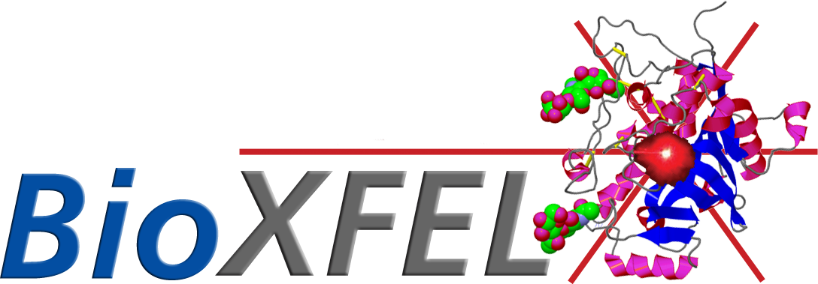
Jose Luis Olmos, Jr. (Joey)
15 April 2015
Notes:
Key background information, the paper’s central purpose or question, and a review of the key results and their significance in a 20-30minute presentation. An excellent presentation would also include some discussion of the research methods, experimental design, and the presenter’s criticisms of the work, but you’ll have to use your own judgment to determine on how much time should be spent on these topics.

Slide 2
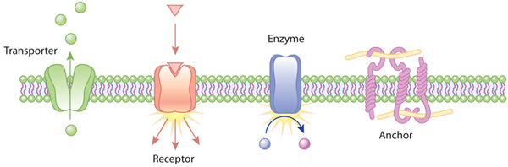
Membrane Proteins
One third of the proteome⁴
60% of current drug targets in humans²
Critical cellular and physiological functions
Structure → Function
Figure 1. Membrane protein functions. (Nature)

Slide 3
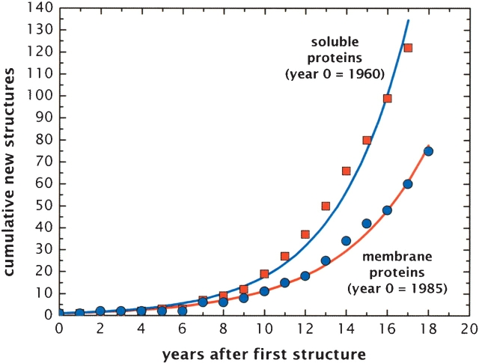
Membrane Protein Crystallization
Development of LCP almost 20 years ago (1996) Landau
Detergent micelle solution
Crystallization of membrane proteins, remove from native lipid bilayers
Lack methods to crystallize membrane proteins for structure determination
Figure 2. Membrane protein structures lag behind soluble membrane structures.¹

Slide 4
Lipidic Cubic Phase (LCP)
Quasisolid membrane environment
Viscoelastic properties, transparent, optically isotropic, viscous and sticky, gel like
LCP one of many phases that form spontaneously
  2 nonintersecting networks of water channels
  More native like environment rather than harsh detergent
  Packing provides more hydrophobic contacts, lower solvent content
Figure 3. Representative LCP schematic. (Landau, PNAS, 1996)

Slide 5
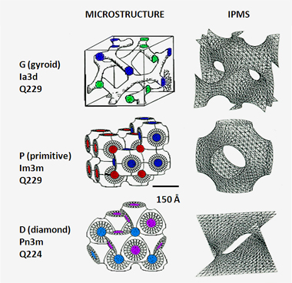
Lipidic Cubic Phase (LCP)
Produces highly ordered crystals, limited in size
Micrometer-sized crystals in initial screening
Not large enough for synchrotron, tedious to optimize larger crystals
Resolution for crystals limited by radiation damage
LCP grown microcrystals are suited for SFX serial femtosecond crystallography
Figure 4. Pn3m is the microstructure in this proof of principle of Smoothened receptor. (Cherezov)

Slide 6
Serial Femtosecond Crystallography (SFX)
“Diffract and destroy”
Duration of X-ray pulses is such that diffracted photons exit sample before photoionization
Data collection at more native temperatures
Work with soluble proteins, aqueous delivery into beam
Gas Dynamic Virtual Nozzle (GDVN)
Figure 5. Experimental set-up for SFX. (Nature 470, 73 – 78 (2011)

Slide 7
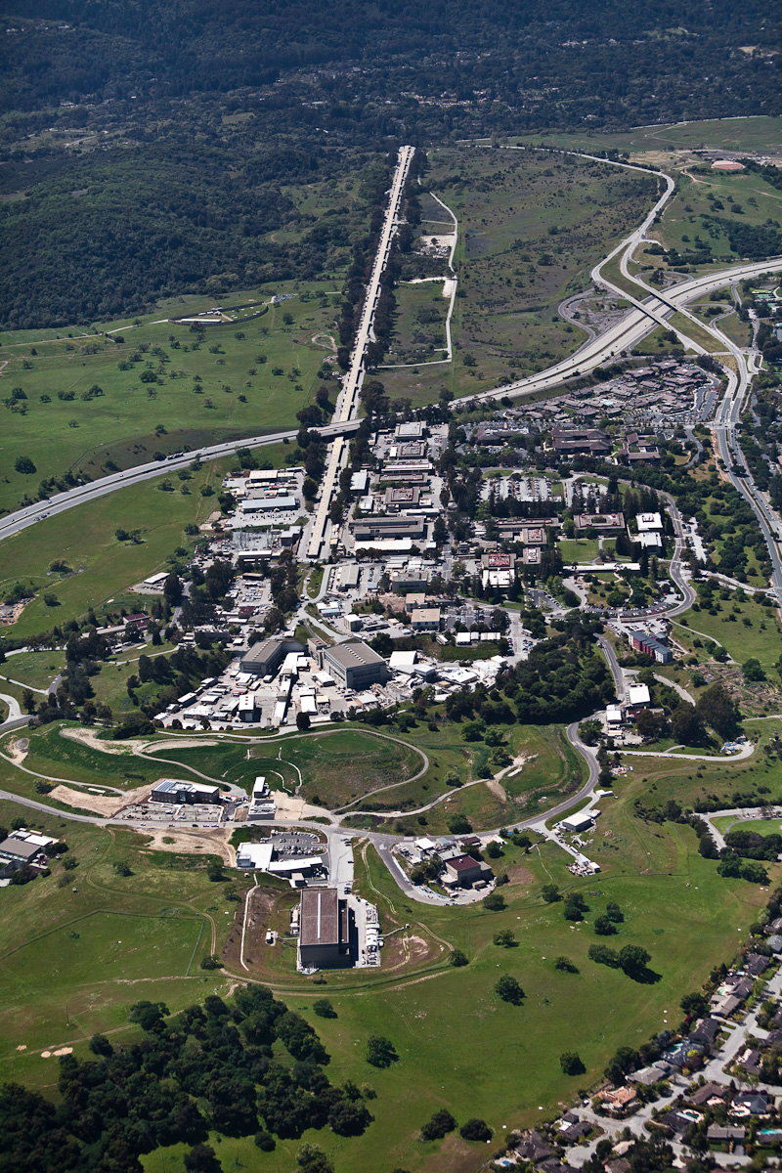
X-ray Free Electron Laser (XFEL)
Stanford 2009 – DOE
Peak brightness of an XFEL is a billion times higher than that of third generation synchrotrons
50fs XFEL energy = 1s synchrotron energy
120Hz pulses
10¹² photons per pulse
Ability to diffract and destroy
Figure 6. Aerial view of SLAC National Laboratory, including XFEL

Slide 8
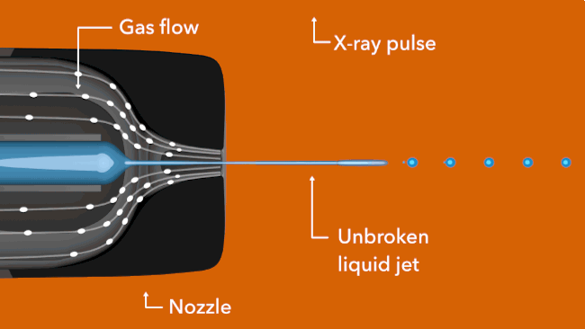
Gas Dynamic Virtual Nozzle (GDVN)
Gas focusing sheath
  supplies hydrated nanocrystals to the pulsed X-ray beam
Not feasible for LCP (highly viscous) – Need for LCP injector
Figure 7. Gas Dynamic Virtual Nozzle. (SLAC National Lab)

Slide 9
LCP Injector Set-up
Injector attached to nozzle rod for insertion to experimental chamber
Water line (blue) provides pressure 300psi, drives hydraulic plunger
Teflon balls provide tight seal against LCP leakage from 20uL LCP reservoir
Gas line (green) for reliable extrusion of LCP and to maintain coaxial flow
Figure 8. LCP Injector schematic. (Weierstall, U. et al. Nat. Commun. 5:3309)

Slide 10
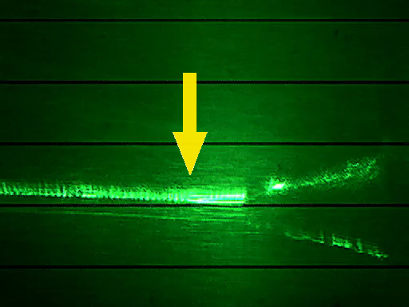
LCP extrusion
Figure 9. LCP Injector movie. (Weierstall, U. et al. Nat. Commun. 5:3309)
Notes:
LCP extrusion with smoothened receptor (SMO) crystals during data collection at the LCLS. The green laser illumination was synchronized with the LCLS X-ray pulses at 120 Hz. The nozzle is visible at the right, the 50 μm diameter jet flows from right to left with a flow velocity of 1.6 mm s⁻¹ 190 nL min⁻¹). The X-ray beam intersects the jet about 100 μm downstream of the nozzle tip, where the jet appearance changes from continuous to chopped (vertical arrow). The X-ray hits are visible as dark ripples on the jet.

Slide 11

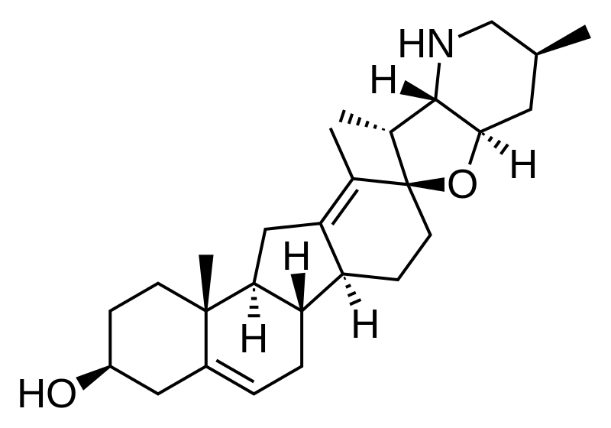
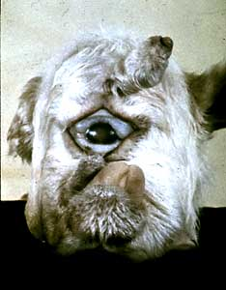
Model Protein: Human Smoothened Receptor
Human Smoothened Receptor
  GPCR-like, frizzled class receptor
  Hedgehog signaling pathway, development, tissue maintenance
  cyclopamine ligand (antagonist) derivatives for cancer treatment
  Corn lily and one-eyed sheep
Figure 10a, b, and c.) Corny lil, cyclopamine, and one-eyed sheep. (Wikipedia)

Slide 12
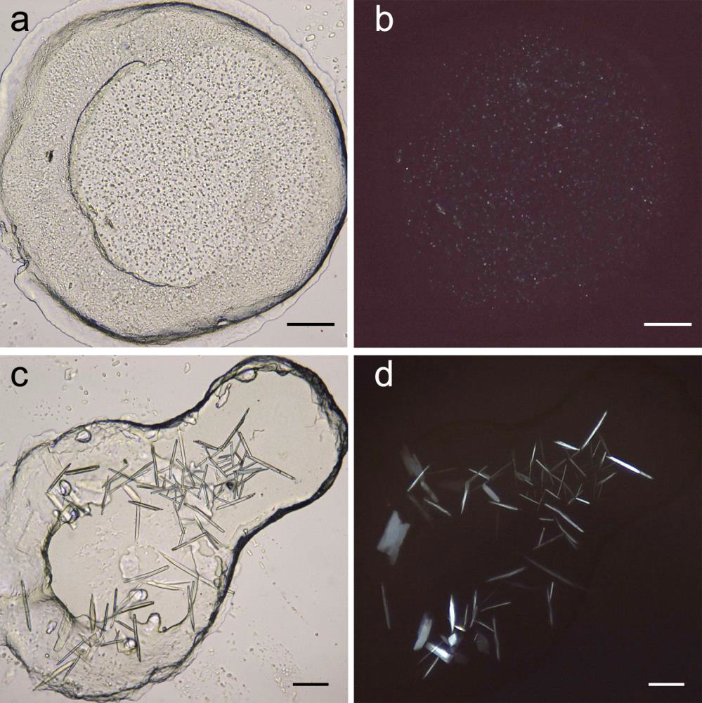
Crystal Growth
Human Smoothened Receptor crystals
SFX (above) Synchrotron (below)
9.0 MAG / 10% (w/w) cholesterol
2:3 (protein:lipid)
100mM Hepes pH 7.0, 30% (v/v) PEG 400, 100mM NaCl
Figure 9. LCP grown human smoothened protein crystals. (Weierstall, U. et al. Nat. Commun. 5:3309)

Slide 13
Structure Recovery
Most commonly used lipid in LCP is monoolein, 9.9 MAG
  Phase transition to lamellar crystalline (L_{c}) phase at 18°C
  LCP injected into evacuated sample chamber at ~10⁻³ Torr and 20°C, so evaporative cooling can transform it into L_{c} phase
    Causing strong, sharp diffraction rings from L_{c phsae}
    Increases background and poses danger to detector
Figure 11a. Diffraction patterns and LCP extrusion. (Weierstall, U. et al. Nat. Commun. 5:3309)

Slide 14
Structure Recovery
    Changing co-flowing gas from He (figure c) to N₂ (figure d) the formation of the L_{c} phase is suppressed but not competely eliminated with LCP prepared with 9.9 MAG
Figure 11c, d. Diffraction patterns and LCP extrusion, scale bar 100um. (Weierstall, U. et al. Nat. Commun. 5:3309)

Slide 15
Structure Recovery
Replacing the 9.9 MAG with shorter chain MAGs (7.9 MAG²² or 9.7 MAG (monopalmitolein) caused the preventation of the L_{c} phase altogether.
Diffraction patterns confirmed the expected cubic-Pn3m phase
Discovered that 7.9 MAG can be added post crystal growth and no damage observed upon addition
Figure 12. Diffraction patterns and LCP extrusion. (Weierstall, U. et al. Nat. Commun. 5:3309)

Slide 16
Diffraction Data and Sample Consumption
LCP injector flow rate of 170nl min⁻¹
5-10h data collection using less than 100uL of sample (<0.5mg of protein)
Vast improvement over GDVN nozzle which requires 10mL (10mg protein) for complete data set
Crystals < 5um at room temperature

Slide 17
Statistics
61,964 microcrystals to recover 3.2/4.0Å resolution structure.
Solved by molecular replacement
Resolution is not very high, but confidently able to locate small molecule
3,510,525 diffraction patterns → 61,964 indexed images with monoclinic lattice
Table 1. Data collection and refinement statistics.. (Weierstall, U. et al. Nat. Commun. 5:3309)

Slide 18
Structure Recovery: PDB ID 4O9R
Figure 13. Cyclopamine binding to smoothened receptor. (Weierstall, U. et al. Nat. Commun. 5:3309)

Slide 19
Implications of LCP Injector development
Previously, aqueous SFX possible with GDVN
Now, LCP—SFX possible with LCP injector
Dramatic reduction of protein sample required
  large amount of pure protein can be difficult to obtain
    Doesn’t purify well (i.e. – toxic to overexpress in cell)
    Protein requires PTM (euk proteins) lack robust cell lines with capability
Expect an increase in number of structures
  Especially elusive, relevant eukaryotic ones that have characteristically been poorly diffracting microcrystals

Slide 20
In Summary
Development of LCP micro-extrusion injector
SFX studies of membrane proteins

Slide 21
References
http://www.ncbi.nlm.nih.gov/pmc/articles/PMC2279940/pdf/0131948.pdf Richard Dickerson (PDB Newsletter 2002)
http://www.nature.com/nrd/journal/v5/n12/pdf/nrd2199.pdf
http://www.nature.com/scitable/topicpage/protein-function-14123348A
http://www.sciencedirect.com/science/article/pii/S0022283600943158
http://cherezov.scripps.edu/resources.htm
http://www.nature.com/ncomms/2014/140214/ncomms4309/extref/ncomms4309-s1.pdf

