Slide 1
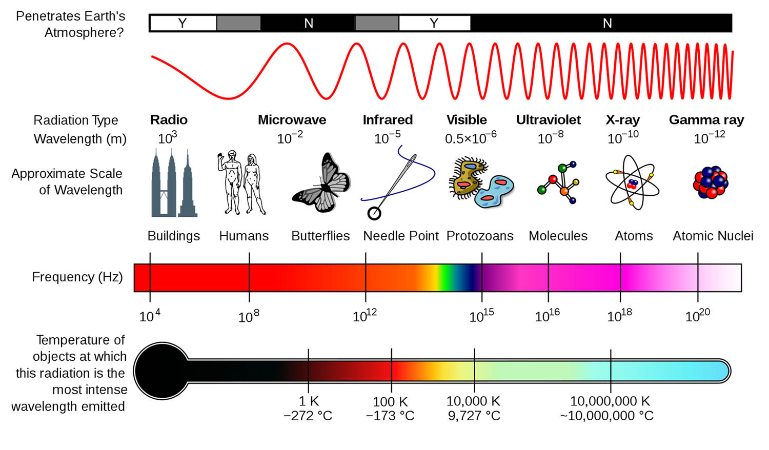
X-rays are electromagnetic waves (like light) and have a wavelength about the size of atoms.
From https://askabiologist.asu.edu/quick-class-x-ray-crystallography
Notes:
X-rays are electromagnetic waves, like light. Their wavelength, the distance between successive crests, troughs or the same points on adjacent waves, is close to the size of atoms. For this reason they can be used to view the world on the atomic scale.

Slide 2

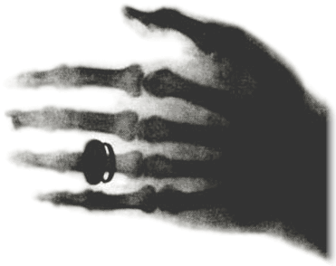
X-rays
X rays are electromagnetic radiation ranging in wavelength from about 100 A to 0.01 Å (1 Å is equivalent to about 10⁻⁸ cm (about 4 billionths of an inch).
The shorter the wavelength of the X ray, the greater is its energy and its penetrating power.
A mixture of many different wavelengths is known as “white” X rays, as opposed to “monochromatic” X rays, which represent only a single wavelength.
Wilhelm Conrad
Röntgen, 1845-1923
The hand of
Albert von Kolliker,
1817-1905. Introduced
many microscopic
mechniques to advance
Histology.

Slide 3
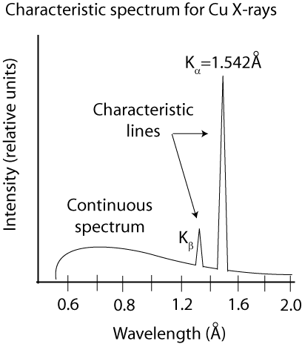
Generation of X-rays in the laboratory
Element | Kα wavelength
Mo | 0.7107
Cu | 1.5418
Co | 1.7902
Fe | 1.9373
Cr | 2.2909

Slide 4
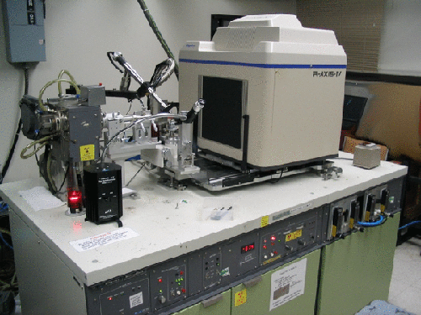
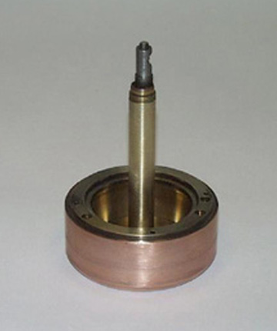
Rotating anode generator
Rotating anode

Slide 5
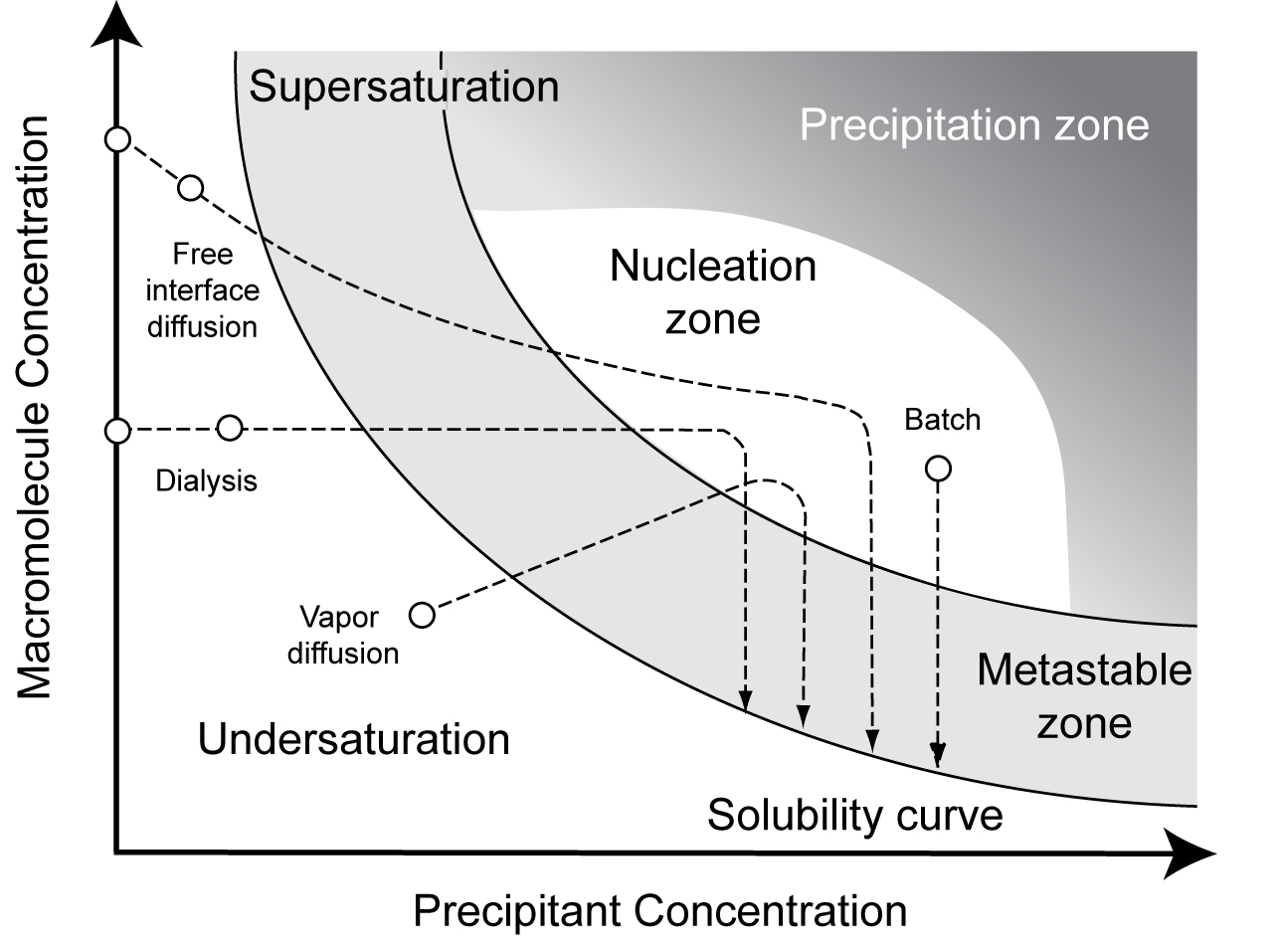
Simplified phase diagram for crystallization
Notes:
5

Slide 6
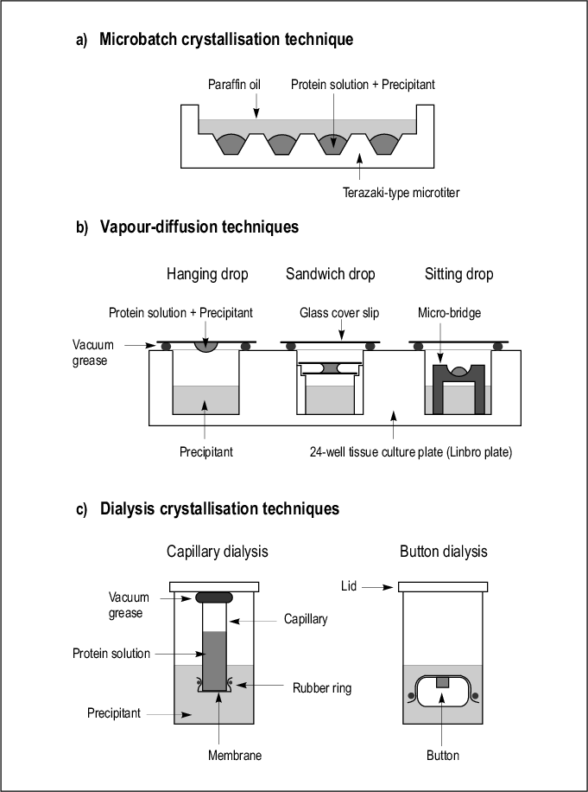
Simplified phase diagram for crystallization
Different techniques traverse the crystallization space differently.
Notes:
6

Slide 7
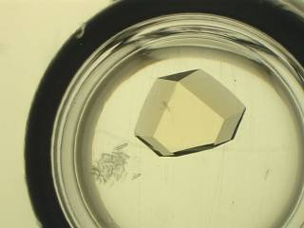

Slide 8
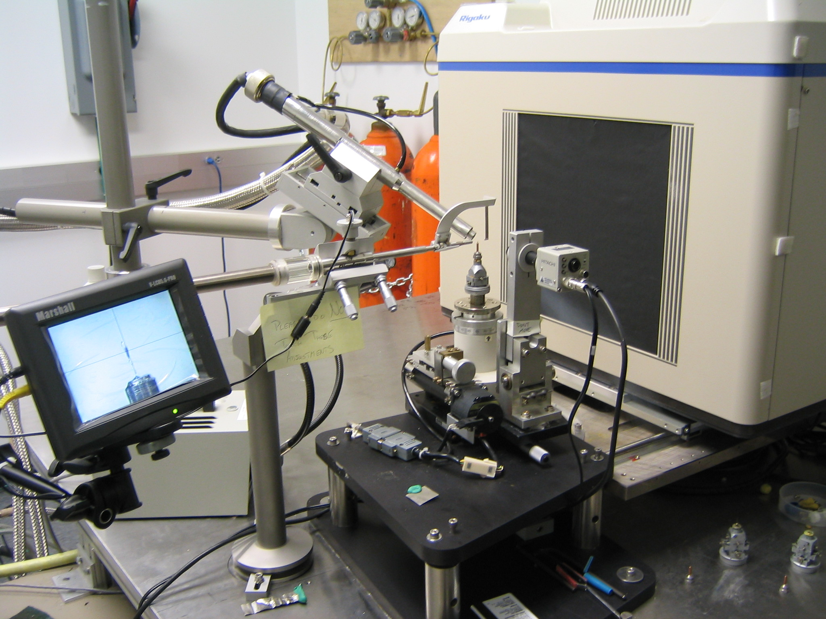

Slide 9
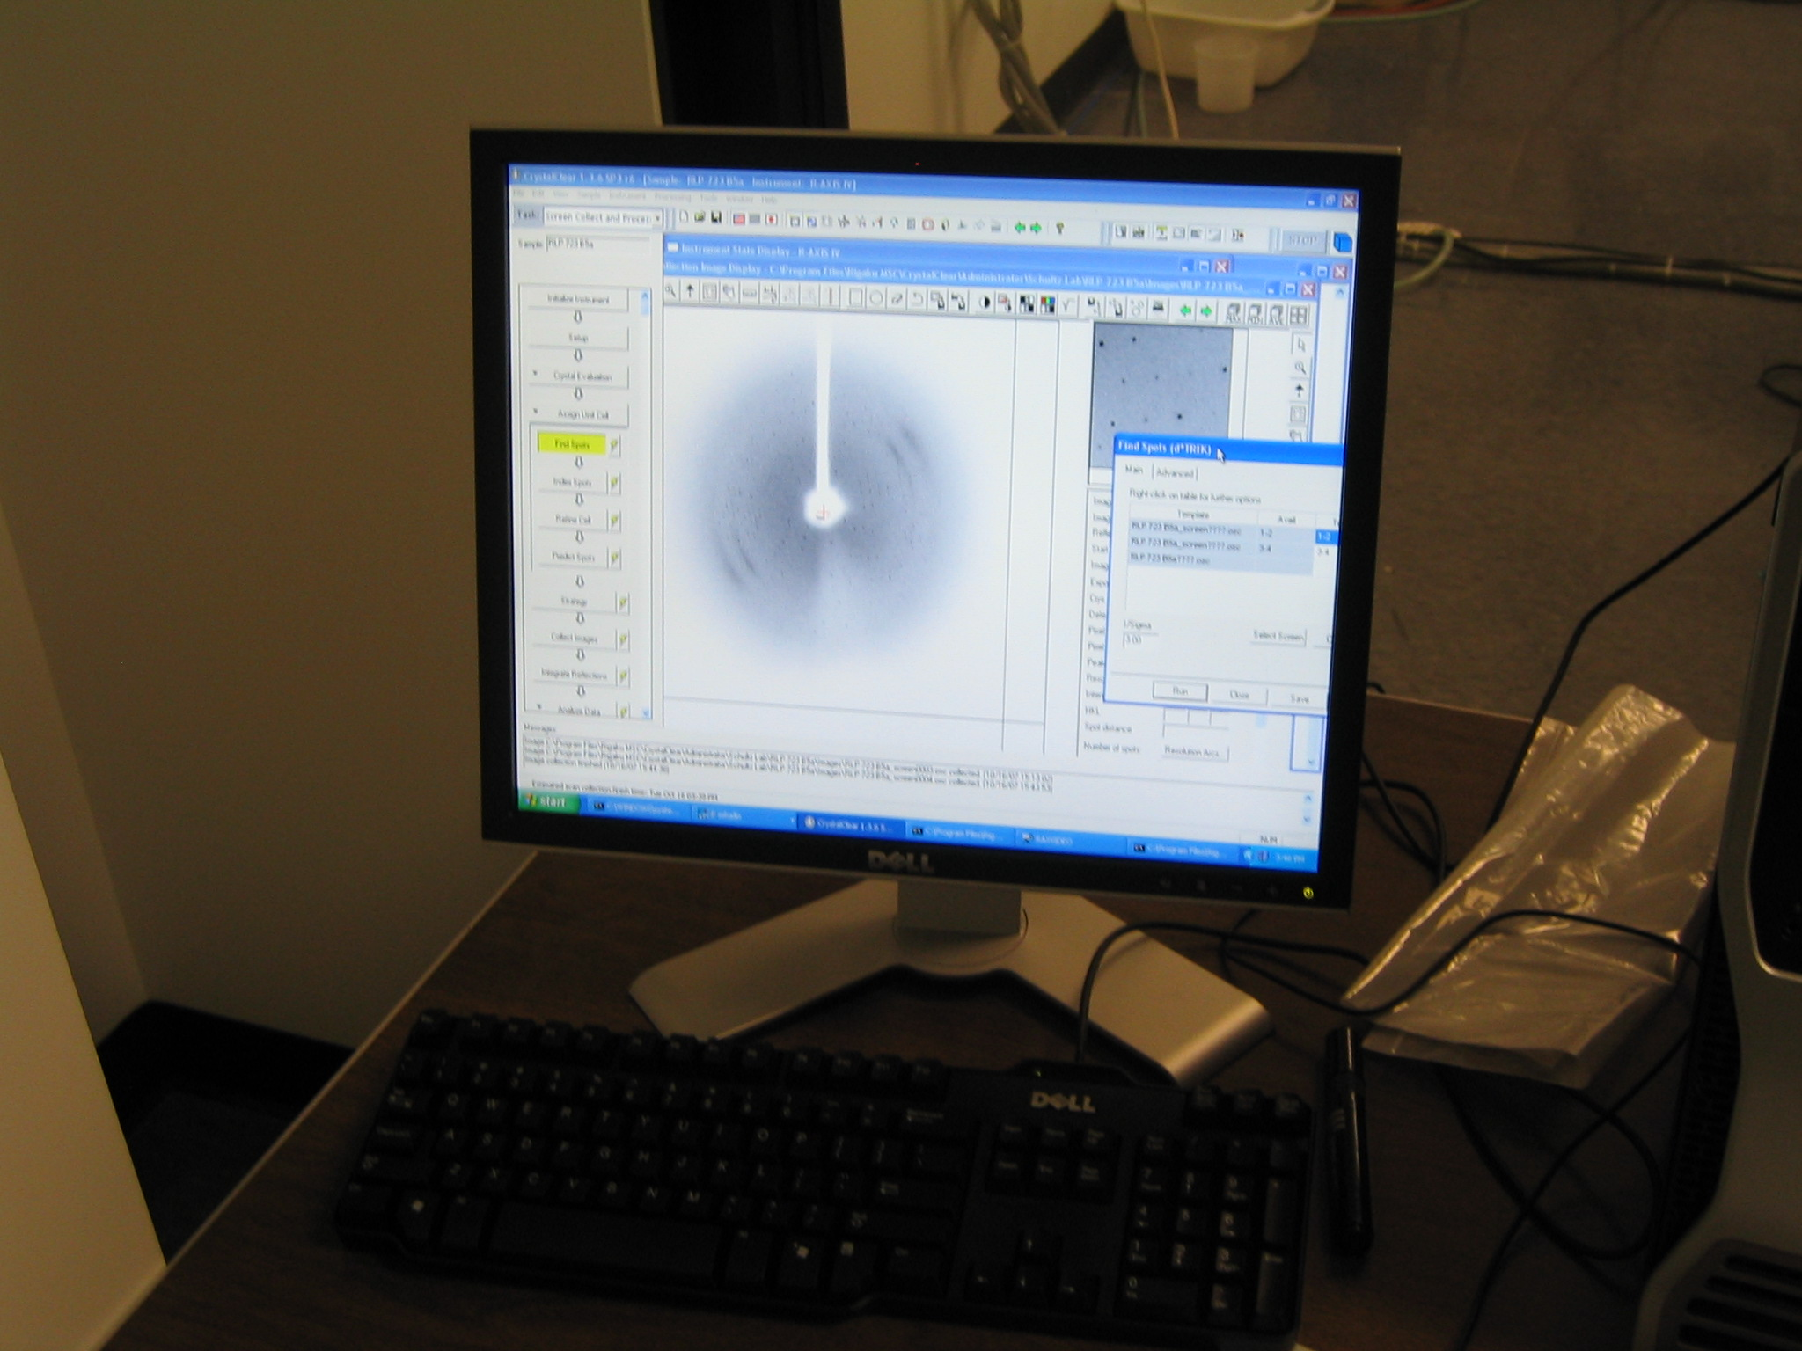

Slide 10
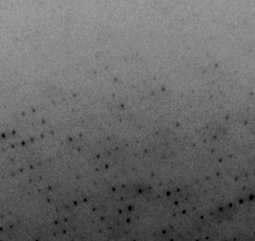
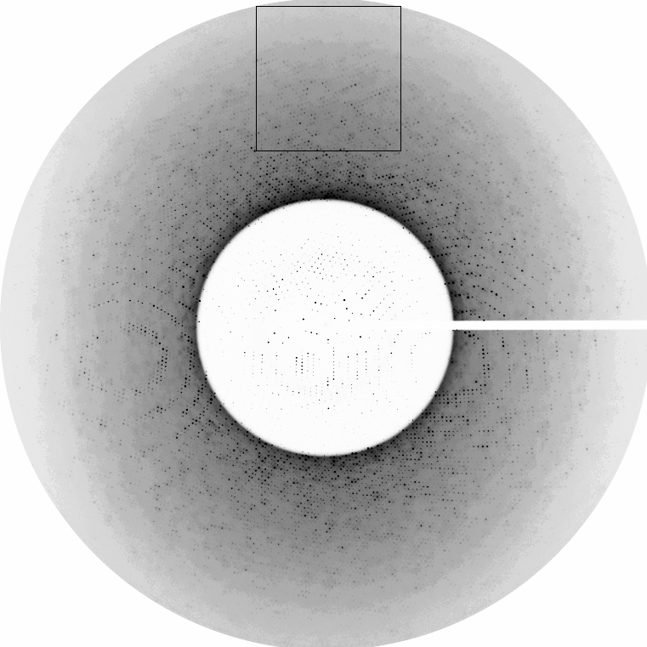
0.9 Å
1.4 Å
Beam stop shadow
Diffracts to beyond 0.85 Å.
In this image ~5000 data points alone are visible.
The total data set at this resolution has over 1 million data points.

Slide 11
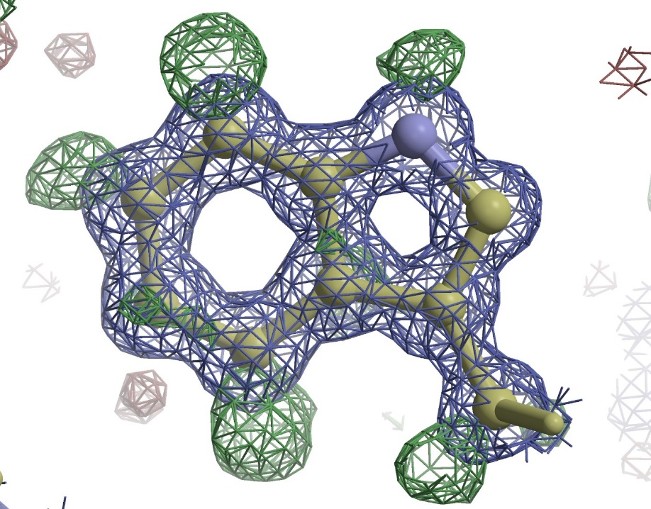
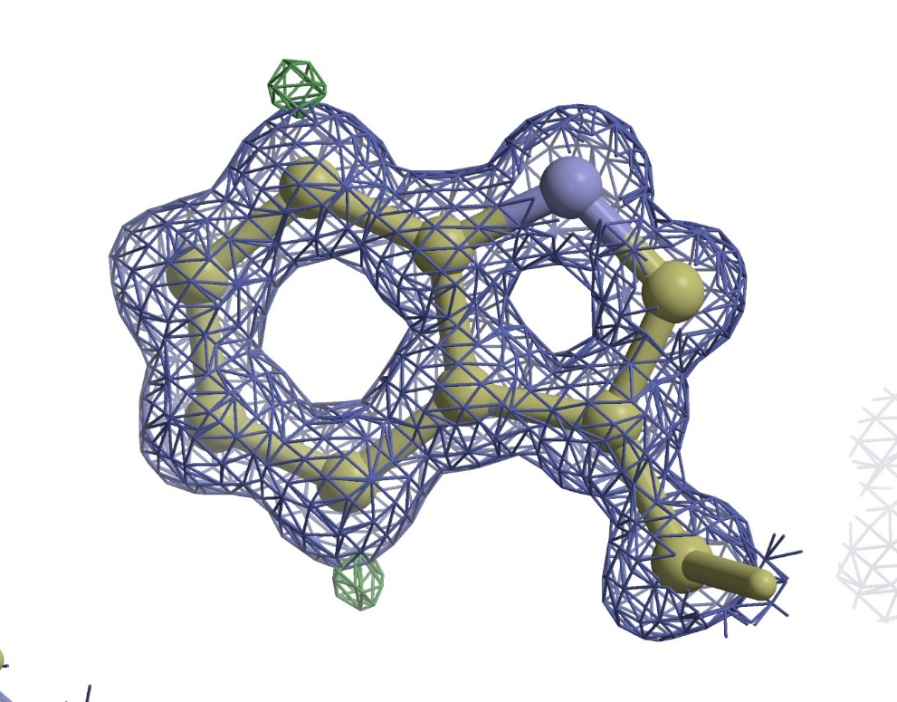
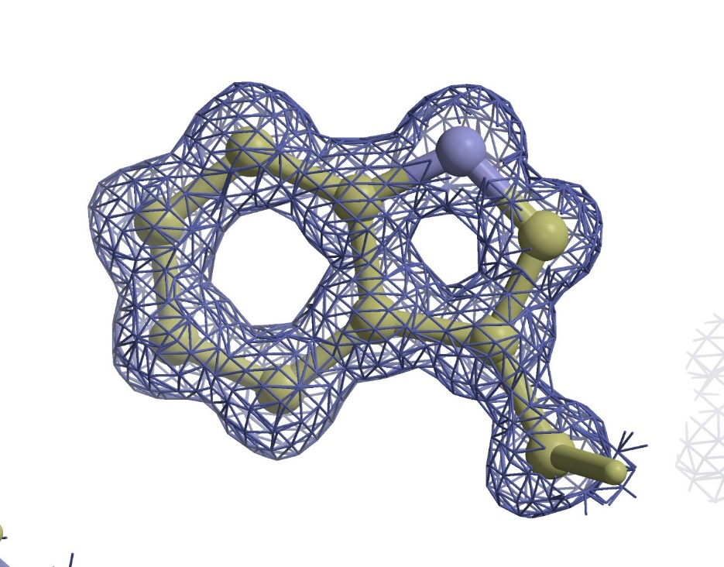
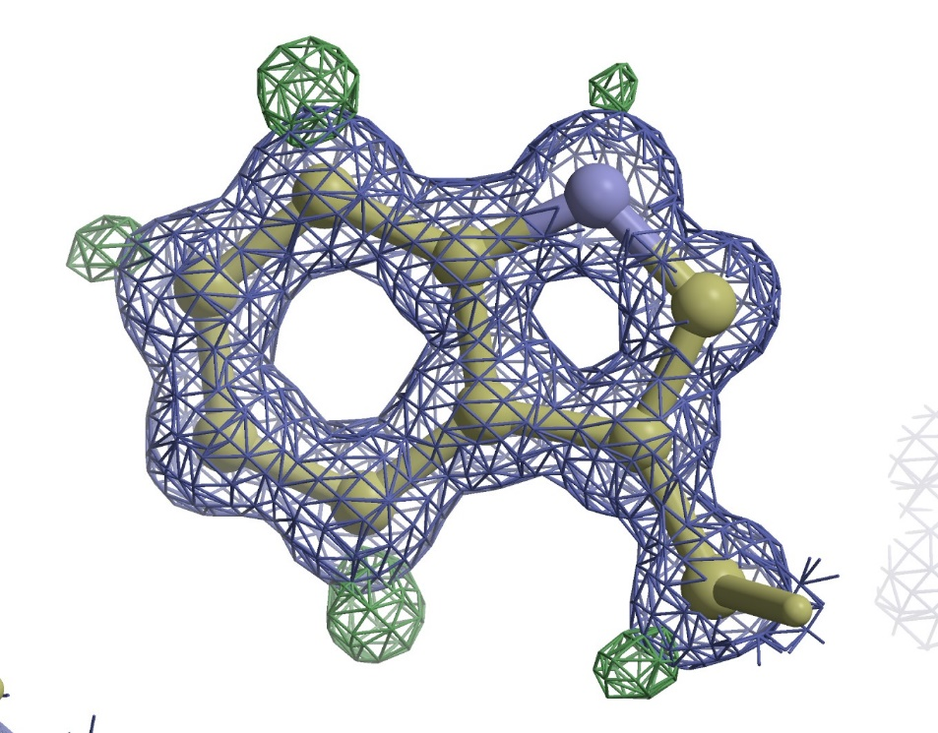
2Fo-Fc 1.0σ
Fo-Fc 2σ
Fo-Fc 4σ
Fo-Fc 3σ
Fo-Fc 5σ

Slide 12
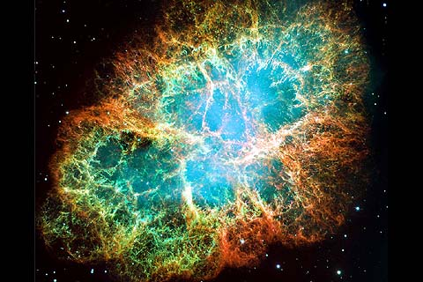
For more signal, need more intensity
The first synchrotron discovered,
the Crab Nebula
(about 6500 light years away)

Slide 13
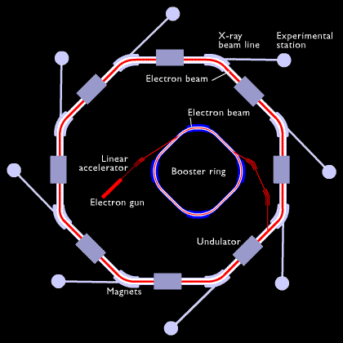
A synchrotron accelerates and stores particles (electrons or protons) moving at speeds close to that of light.
As the particles loose energy they give of electromagnetic radiation.
The particles are steered by magnetic fields.
Electromagnetic radiation (photons) is not affected by these fields and is emitted at the tangent to the change in direction.
Insertion devices (undulators and wigglers) ‘amplify’ this radiation

Slide 14
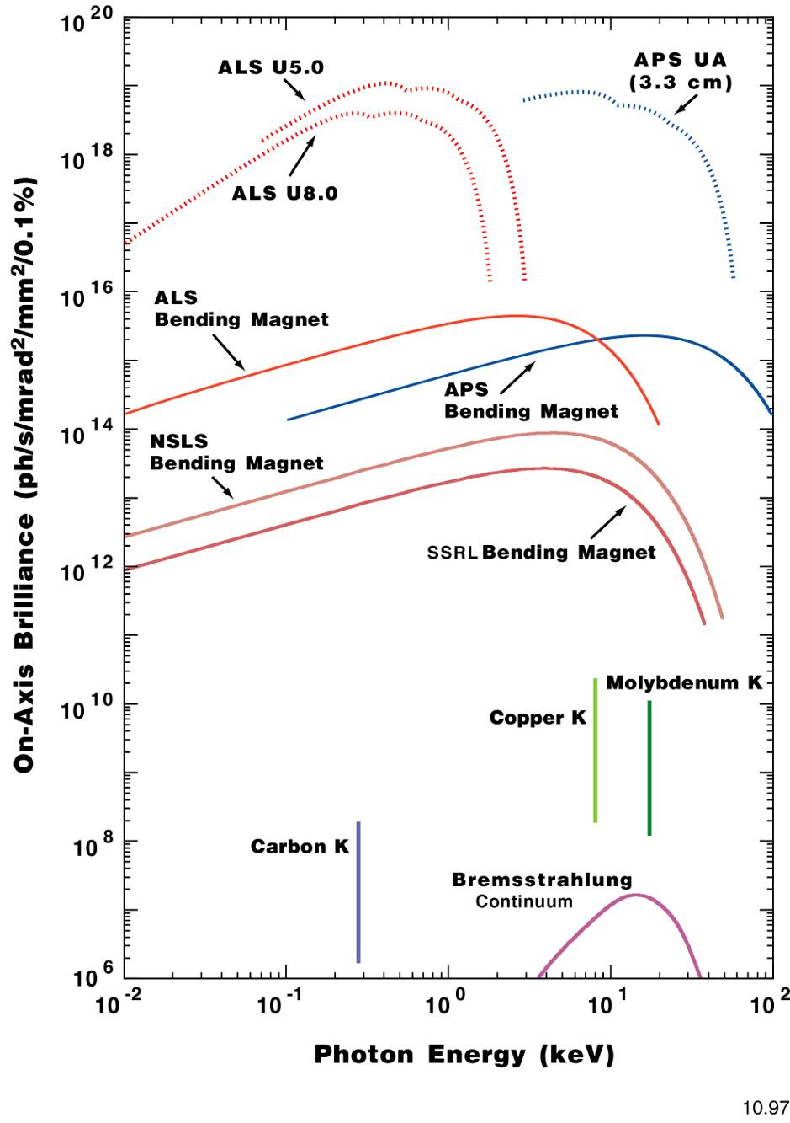
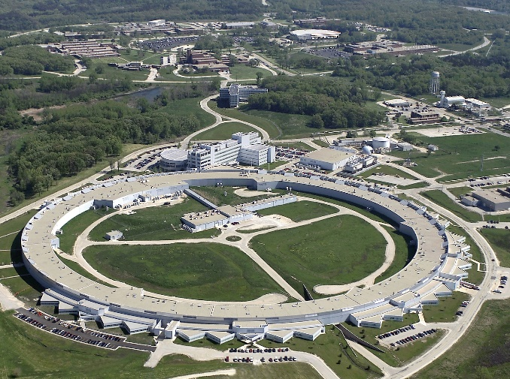
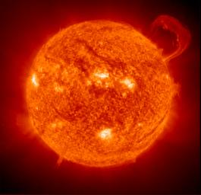

Synchrotron radiation is 10⁹ times
More brilliant than the sun
and about 100 million miles closer

Slide 15

Linear accelerator
Booster Ring
Synchrotron
Beamline

Slide 16
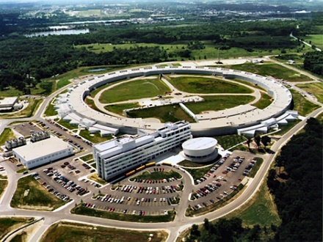
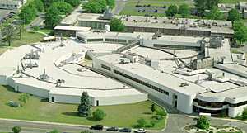

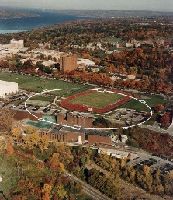
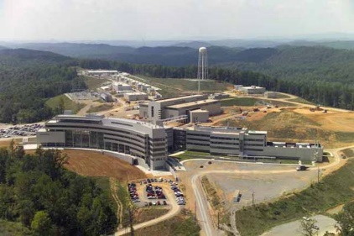
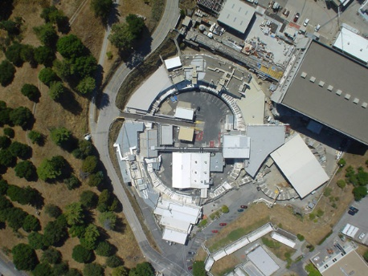
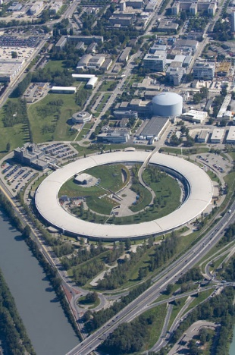
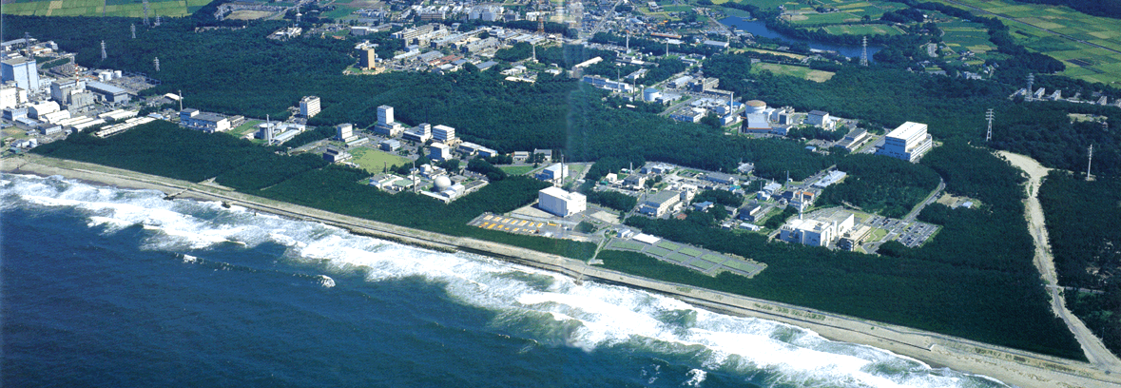
Where?
NSLS
APS
CHESS
SNS
SSRL
ILL
JAERI
Synchrotron X-ray sources we are actively using
Neutron sources we are actively using

Slide 17

A candle provides light
Notes:
Introduction. Let there be light. The discovery of fire and the much later invention of candles allowed civilization to make good use of the night. A modern candle provides 1 candlepower or 13 lumens of light . We won’t delve into the definition of candlepower or lumens but it provides a measure of the light output. The heat produced during this process is about 80W

Slide 18

More candles provide more light
“Evolutionary technology”
Massimo Catarinella
Notes:
A candelarbra obviously produces more light. It is an evolutionary technology where the same technological basis has been used but improved, i.e. more candles provide more light.

Slide 19

A light bulb also provides light.
But it is an example of revolutionary technology
It changed the way we do things
Notes:
The light bulb also provides light but is an example of revolutionary technology involving new physical principles that provide light but supplant the capability of a candle. For less than the 80W of energy put out by a candle they produce almost two orders of magnitude light output.

Slide 20

We are here now!
Synchrotron radiation is 10⁹ times
More brilliant than the sun
and about 100 million miles closer

Slide 21
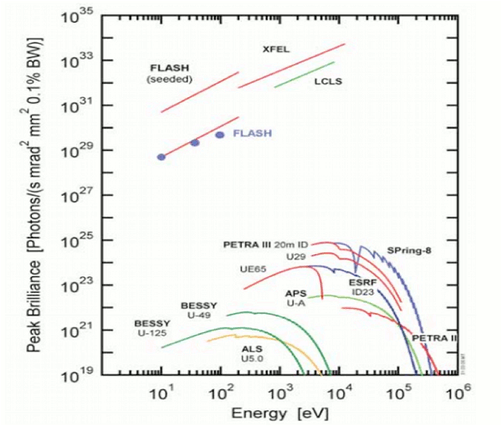

Slide 22
The Linear Coherent Light Source XFEL
X-ray Free Electron Lasers (XFEL’s) are revolutionary sources of X-ray radiation
They are changing the way and the kind of X-ray based science we can do
Photo courtesy of SLAC National Accelerator Laboratory
Notes:
X-rays have been used for over 100 years since their discovery. You may have come across them in a hospital or dentists office. One area of scientific application is in the study of matter at the atomic scale. There are a number of ways of producing X-ray radiation and many devices but recently a development akin to the jump form a candle to a light bulb but much larger has taken place, the invention and building of X-ray free electron lasers.

Slide 23
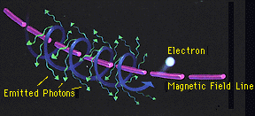
Moving electrons can emit X-rays through several processes, in our case the emission (synchrotron radiation) is caused by changing direction due to a magnetic field
The force felt by a charged particle (an electron in this case) in a magnetic field is perpendicular to the direction of the field and to the direction of the particle's velocity. The net effect of this is to cause the particle to spiral around the direction of the field. Since circular motion represents acceleration (i.e., a change in velocity), electrons radiate photons (which include X-rays) of a characteristic energy, corresponding to the radius of the circle
Image from NASA

Slide 24
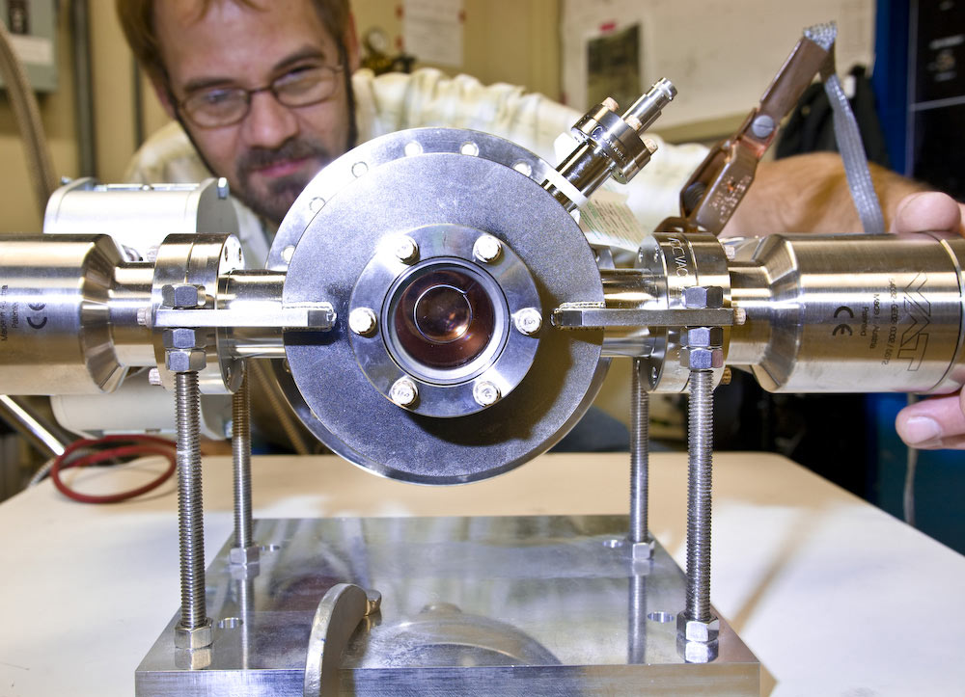
The first part of an XFEL, the injector, is used to generate electrons
In the LCLS case (an XFEL at Stanford) the injector cathode is a highly polished copper plate. A short burst of light from a drive laser hits the cathode's shiny surface and produces one electron for every 100,000 photons (image from of LCLS)

Slide 25

Injector
}
Not exact to scale

Slide 26
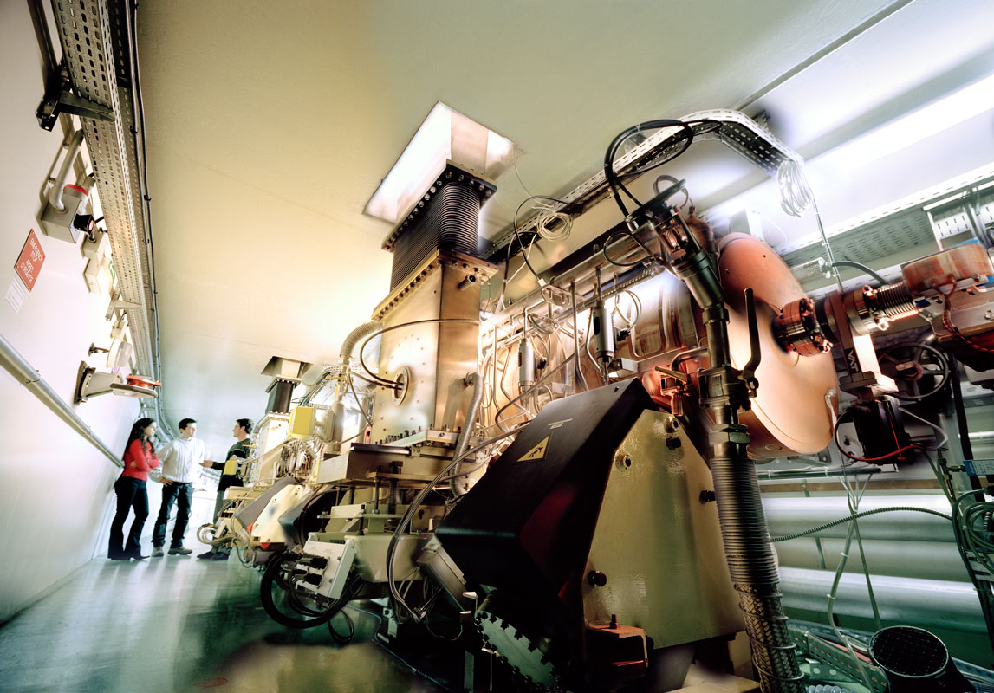
The electrons are accelerated by a radio frequency accelerator (a radio station!)
ESRF

Slide 27

Injector
Accelerator
}
Not exact to scale

Slide 28
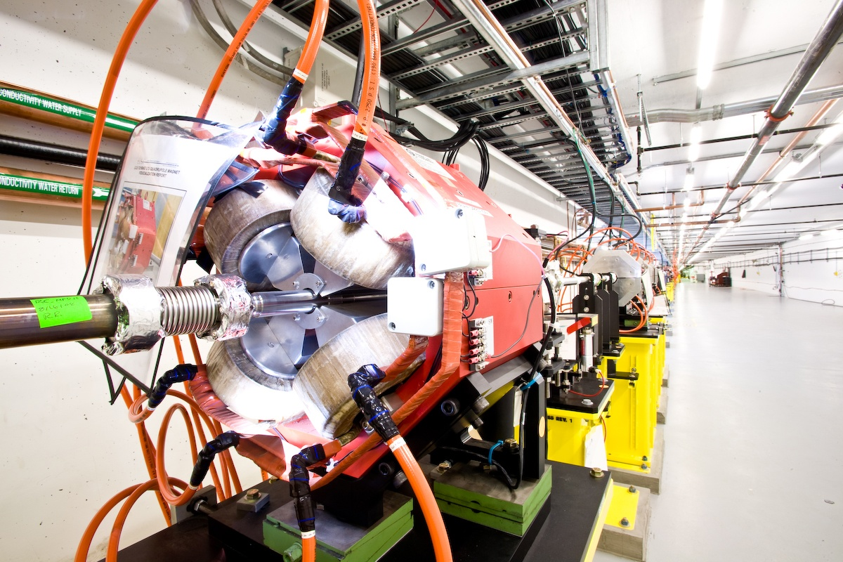
They are steered by magnets

Slide 29
Injector
Accelerator
Steering
Not exact to scale

Slide 30
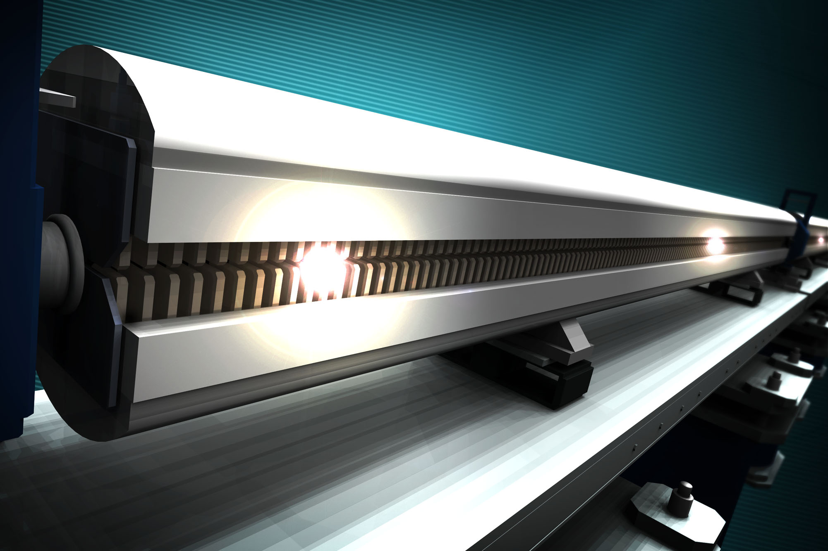
The accelerated electrons run through undulators
And go through an undulater, a series of alternating pole magnets
Image by Greg Stewart, SLAC

Slide 31
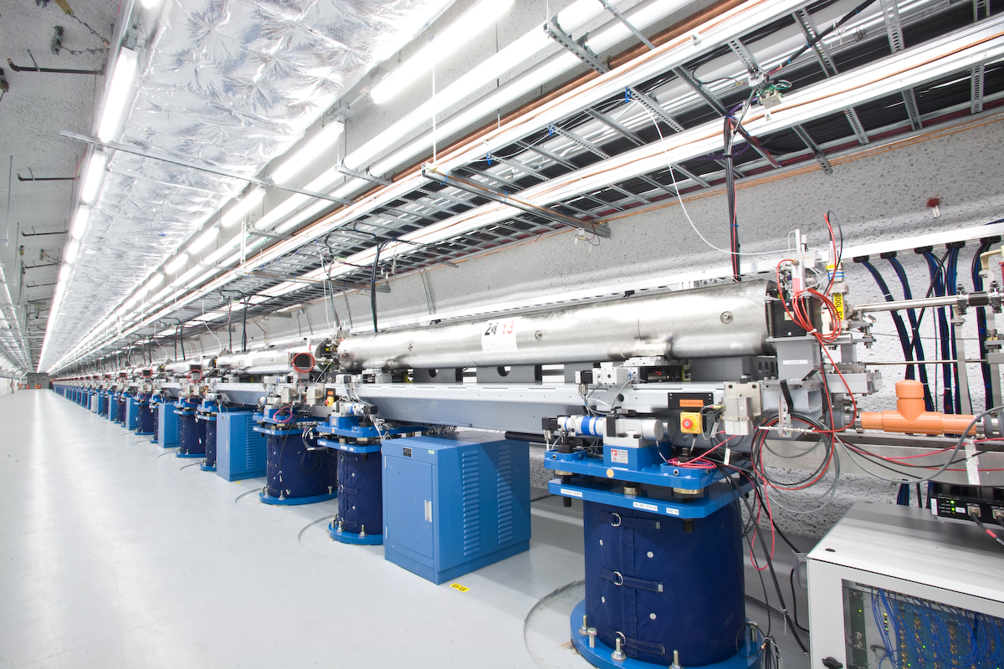
LCLS

Slide 32
Injector
Accelerator
}
Steering
Undulator
Not exact to scale

Slide 33
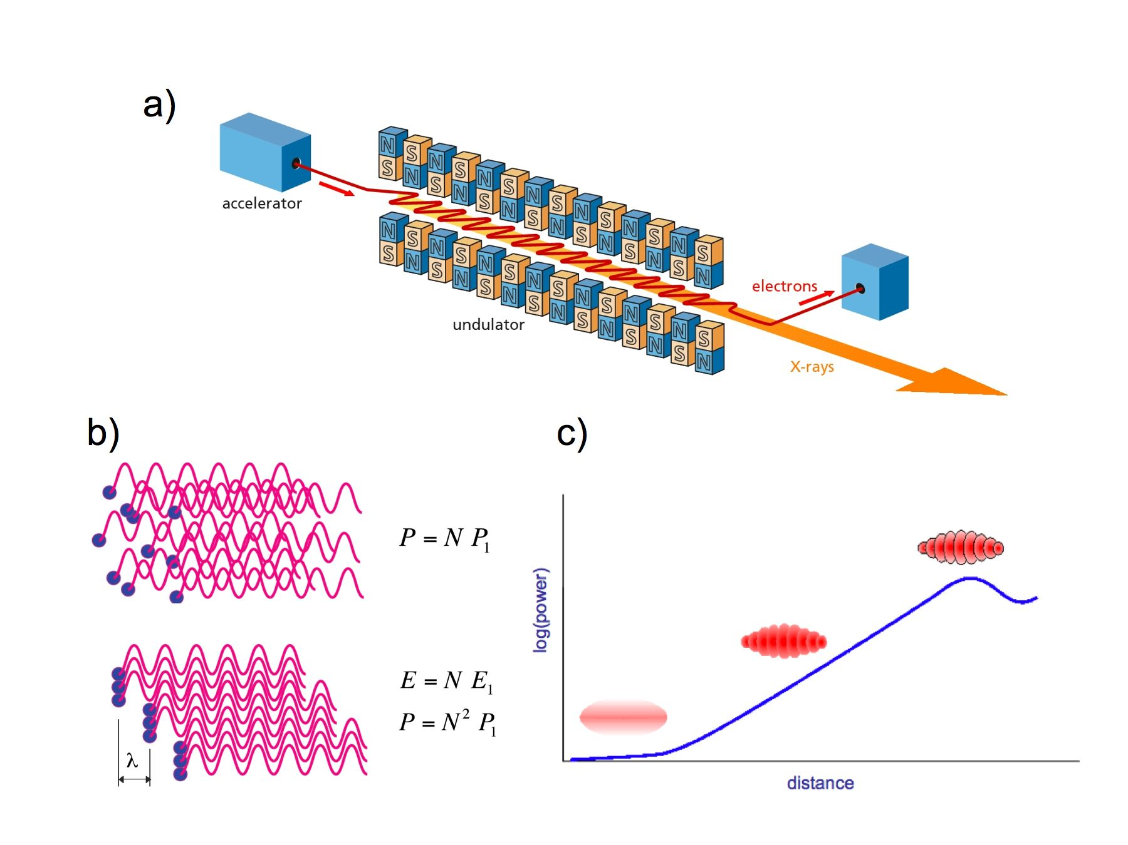
Relativistic effects combine to produce bunches of correlated electrons
www.psi.ch

Slide 34
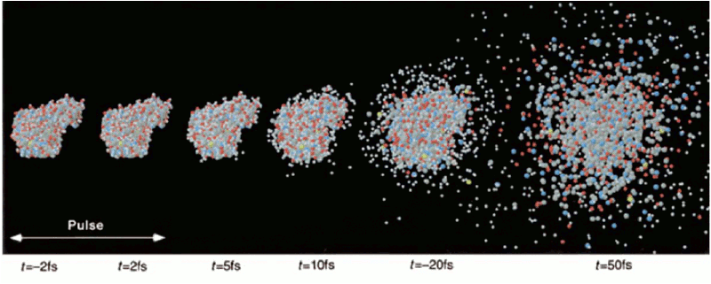
This results in intense but short pulses of X-rays
-2 fs
2 fs
5 fs
10 fs
20 fs
50 fs
One fs is 10⁻¹⁵ s
Neutze et al 2000

Slide 35
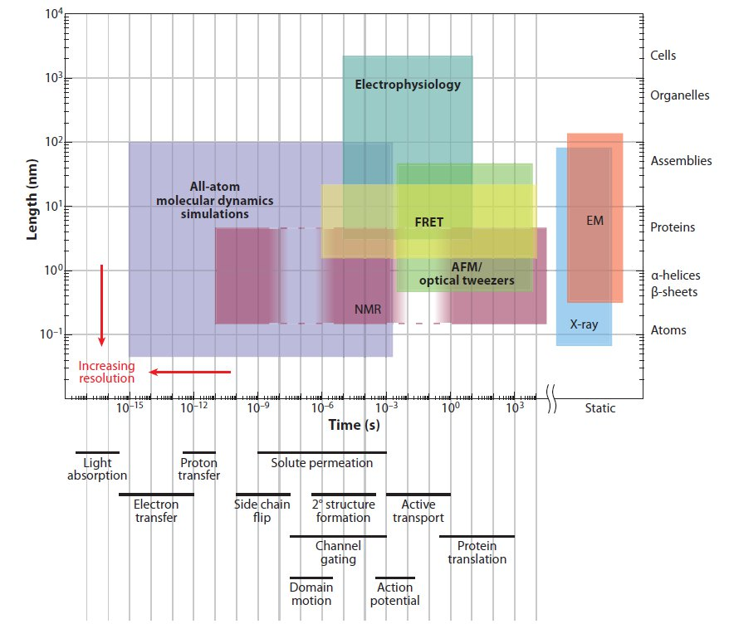
X-ray lasers open up
http://mappingignorance.org/2013/02/12/exceptional-problems-demand-exceptional-computers/

